Slide 1
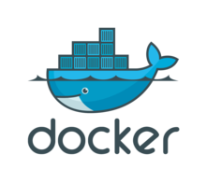

Docker 101*
* Build, Ship, and Run Anywhere

Slide 2
Agenda
Why we need Docker ?
Evolution of Deployments.
What is Container ?
Container vs Virtual Machine
What is Docker
Docker CLI
Docker Architecture
Docker Installation
Docker Platform Workﬂow
Docker Build AND Run Commands

Slide 3
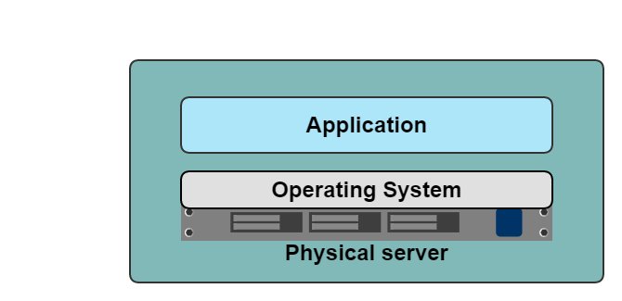
One application on one physical server

Slide 4
Historical limitations of application deployment
Slow deployment times
Huge costs
Wasted resources
Difficult to scale
Difficult to migrate
Vendor lock in

Slide 5
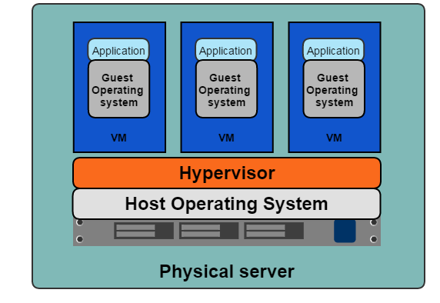
A History Lesson
One physical server can contain multiple applications
Each application runs in a virtual machine (VM)

Slide 6

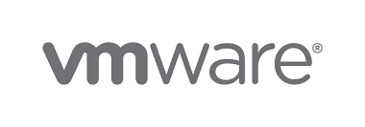
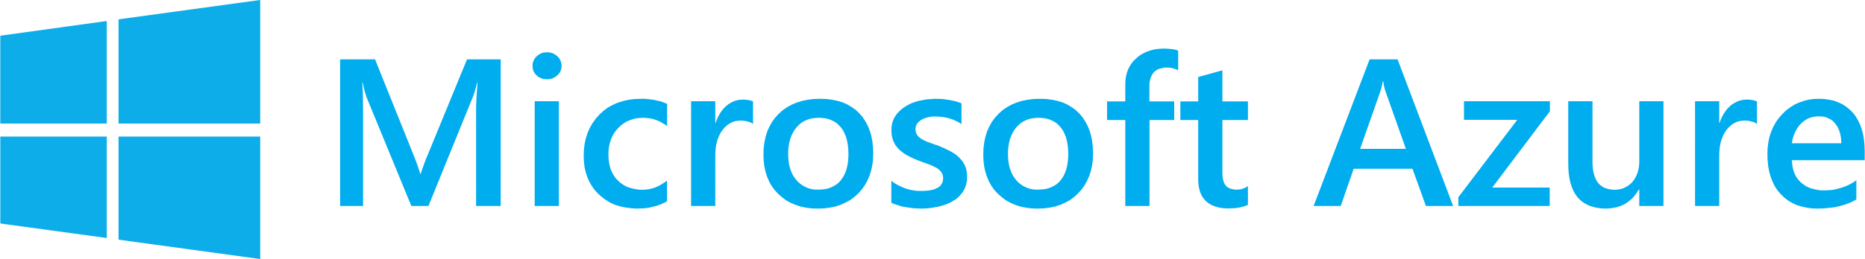
Benefits of VMs
Better resource pooling
One physical machine divided into multiple virtual machines
Easier to scale
VMs in the cloud
Rapid elasticity
Pay as you go model

Slide 7
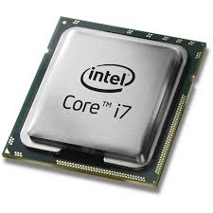
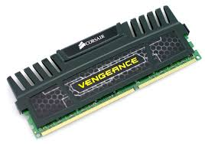
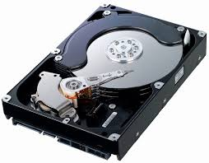
Limitations of VMs
Each VM stills requires
CPU allocation
Storage
RAM
An entire guest operating system
The more VMs you run, the more resources you need
Guest OS means wasted resources
Application portability not guaranteed

Slide 8
History of Docker
2013
Solomon Hykes starts Docker as an internal project within dotCloud
Feb 2016
Docker introduces first commercial product – now called Docker Enterprise Edition
2008
Linux containers (LXC 1.0) introduced
Mar 2013
Docker released to open source
Today
Open source community includes:
3,300+ contributors
43,000+ stars
12,000+ forks
2004
Solaris Containers / Zones technology introduced

Slide 9
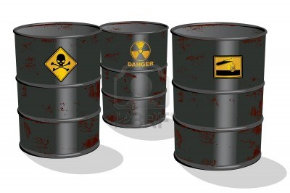
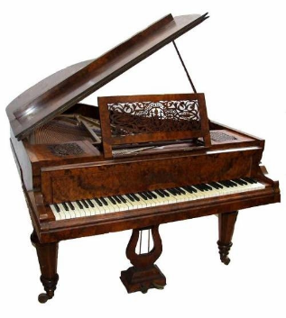
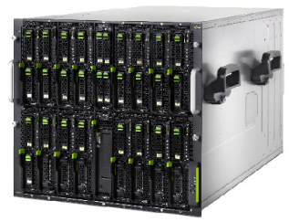
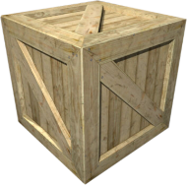
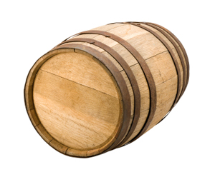
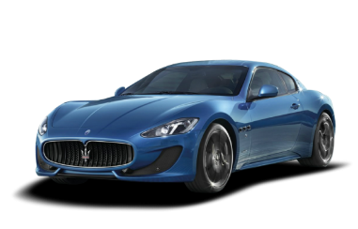
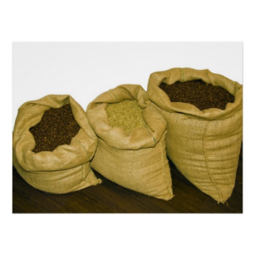

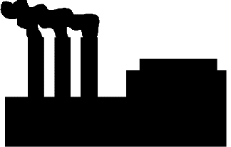

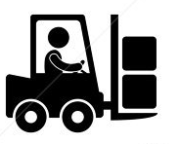
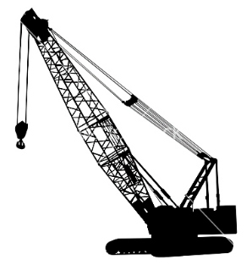
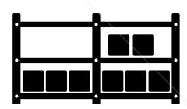

Cargo Transport Pre-1960
Do I worry about how goods interact (e.g. coffee beans next to spices)
Multiplicity of Goods
Multipilicity of methods for transporting/storing
Can I transport quickly and smoothly
(e.g. from boat to train to truck)

Slide 10

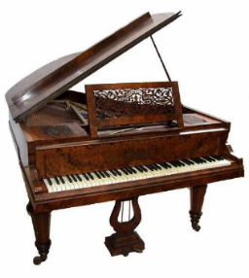

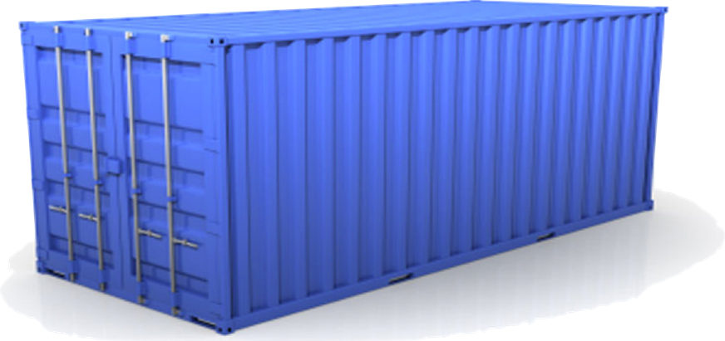
Solution: Intermodal Shipping Container
Do I worry about how goods interact (e.g. coffee beans next to spices)
Multiplicity of Goods
A standard container that is loaded with virtually any goods, and stays sealed until it reaches final delivery.
…in between, can be loaded and unloaded, stacked, transported efficiently over long distances, and transferred from one mode of transport to another
Can I transport quickly and smoothly
(e.g. from boat to train to truck)
Multiplicity of methods for transporting/storing

Slide 11
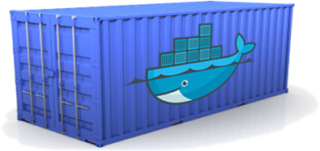
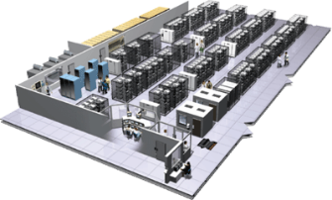
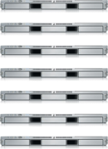
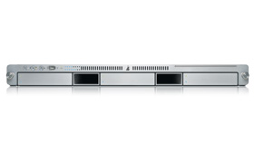



Or…put more simply
Static website
User DB
Web frontend
Queue
Analytics DB
Do services and apps interact appropriately?
Multiplicity of Stacks
Developer: Build Once, Run Anywhere (Finally)
Operator: Configure Once, Run Anything
Multiplicity of hardware environments
Can I migrate smoothly and quickly
Development VM
QA server
Customer Data Center
Public Cloud
Production Cluster
Contributor’s laptop

Slide 12
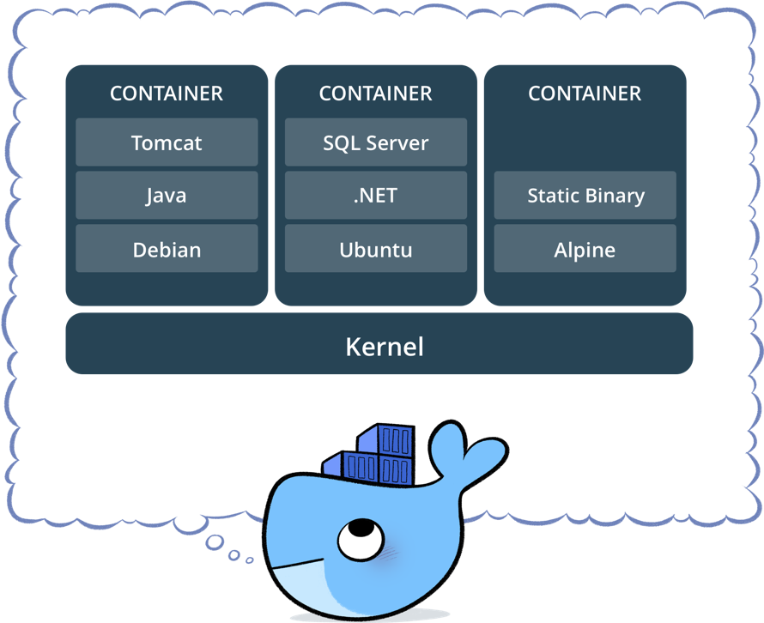
What is a container?
Standardized packaging for software and dependencies
Isolate apps from each other
Share the same OS kernel
Works with all major Linux and Windows Server
Notes:
Hypervisor based VM’s were a massive improvement over the one application on one server approach. But they were not without limitations.
First, each VM still required its own CPU, RAM, storage etc… and each VM needs to have an operating system installed. An entire operating system, which consumes a lot of resources but doesn’t provide us with much in return. We just have it there so we can run our application. And so the more VM’s you run, the more resources you need

Slide 13
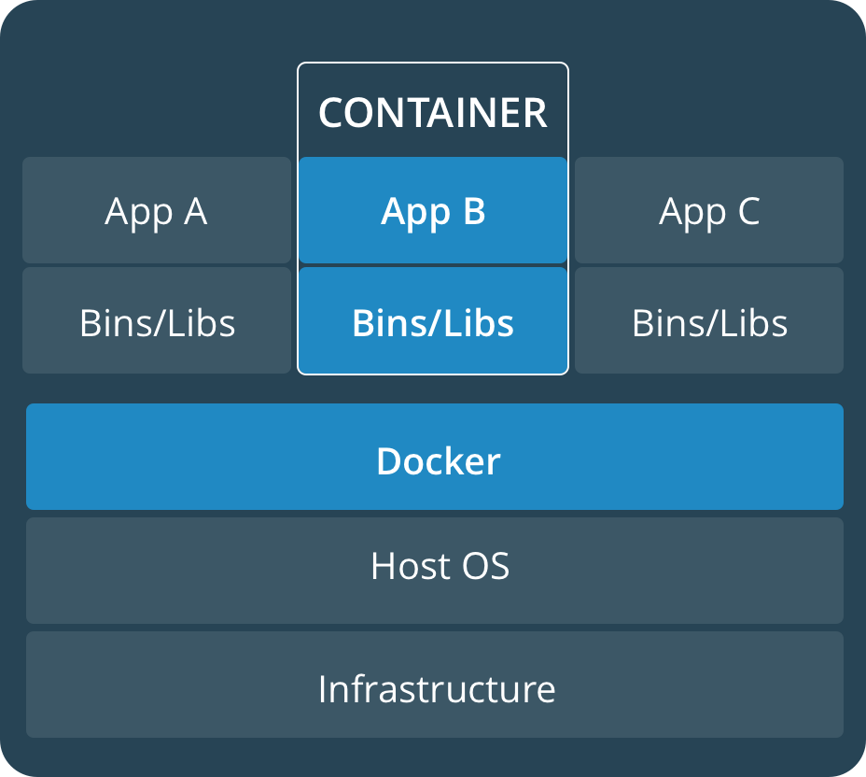
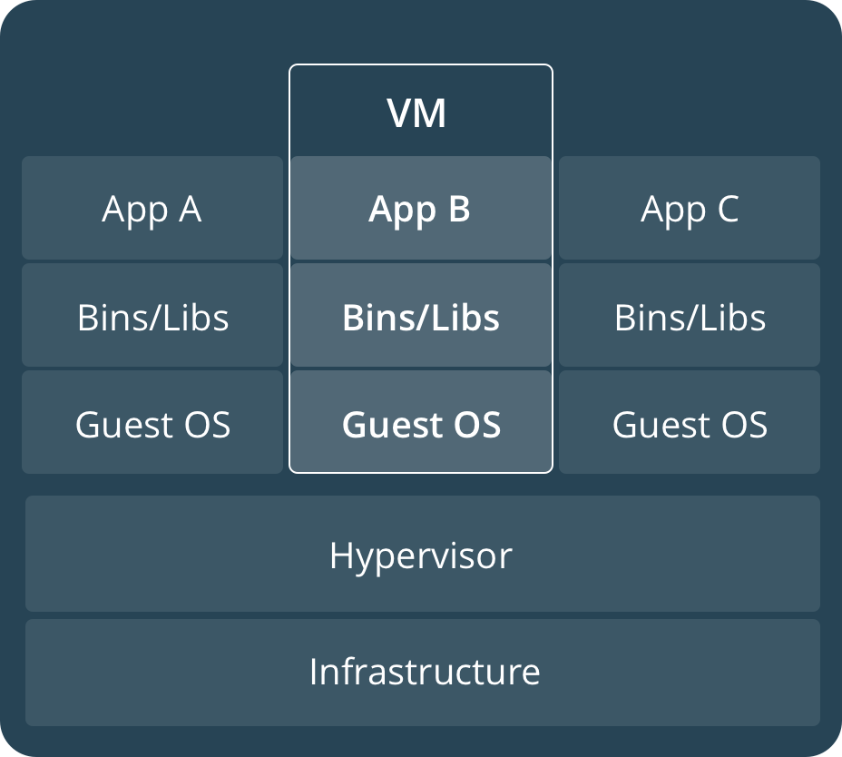
Comparing Containers and VMs
Containers are an app level construct
VMs are an infrastructure level construct to turn one machine into many servers
Notes:
Hypervisor based VM’s were a massive improvement over the one application on one server approach. But they were not without limitations.
First, each VM still required its own CPU, RAM, storage etc… and each VM needs to have an operating system installed. An entire operating system, which consumes a lot of resources but doesn’t provide us with much in return. We just have it there so we can run our application. And so the more VM’s you run, the more resources you need

Slide 14
Vm vs Docker

Slide 15
Key Benefits of Docker Containers
Speed
No OS to boot = applications online in seconds
Portability
Less dependencies between process layers = ability to move between infrastructure
Efficiency
Less OS overhead
Improved VM density
Notes:
Hypervisor based VM’s were a massive improvement over the one application on one server approach. But they were not without limitations.
First, each VM still required its own CPU, RAM, storage etc… and each VM needs to have an operating system installed. An entire operating system, which consumes a lot of resources but doesn’t provide us with much in return. We just have it there so we can run our application. And so the more VM’s you run, the more resources you need

Slide 16
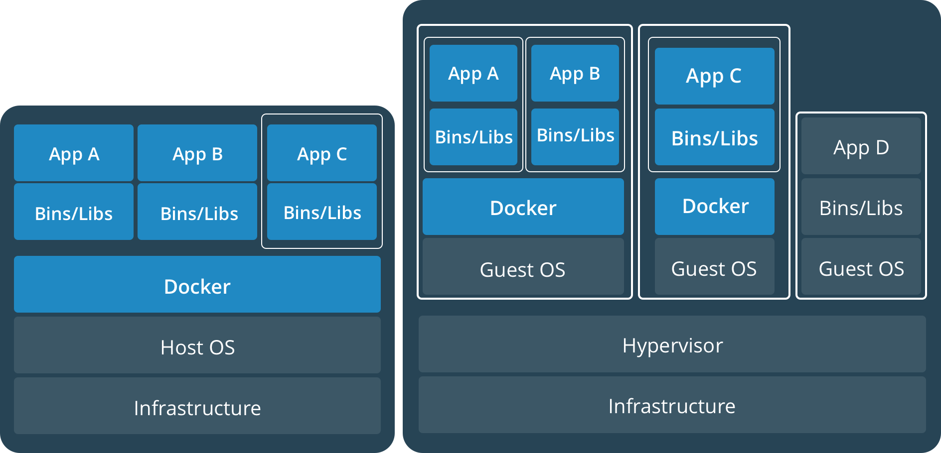
Containers and VMs together
PROD
DEV
Containers and VMs together provide a tremendous amount of flexibility for IT to optimally deploy and manage apps.
Notes:
Hypervisor based VM’s were a massive improvement over the one application on one server approach. But they were not without limitations.
First, each VM still required its own CPU, RAM, storage etc… and each VM needs to have an operating system installed. An entire operating system, which consumes a lot of resources but doesn’t provide us with much in return. We just have it there so we can run our application. And so the more VM’s you run, the more resources you need

Slide 17
What is Docker
Docker is a tool designed to make it easier to create, deploy, and run applications by using containers
Notes:
Docker is a tool designed to make it easier to create, deploy, and run applications by using containers. Containers allow a developer to package up an application with all of the parts it needs, such as libraries and other dependencies, and ship it all out as one package. By doing so, thanks to the container, the developer can rest assured that the application will run on any other Linux machine regardless of any customized settings that machine might have that could differ from the machine used for writing and testing the code.

Slide 18
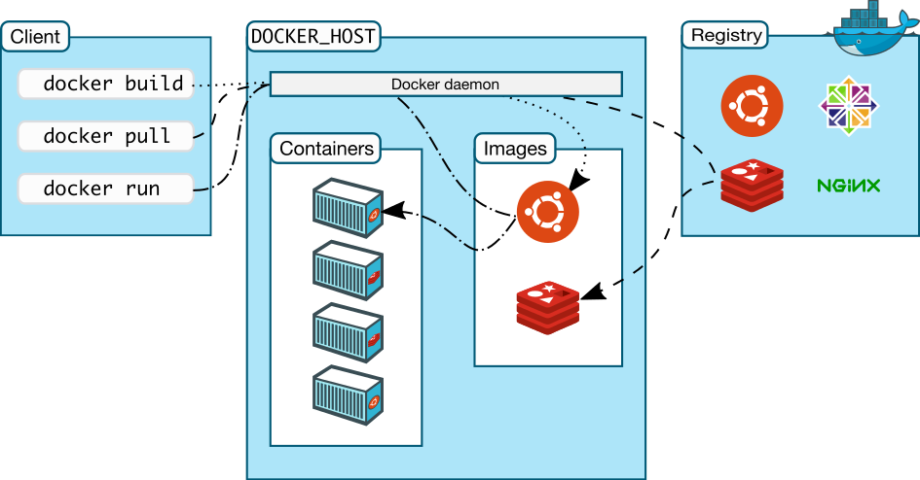
Docker architecture

Slide 19
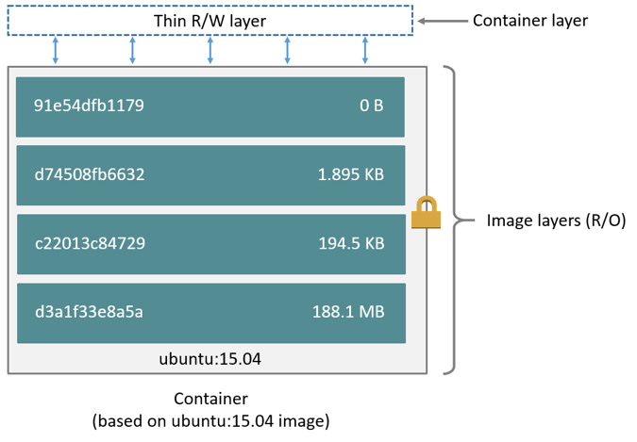
Docker Images

Slide 20
Docker Workflow
docker run -i -t -d ubuntu:15.04 /bin/bash
Pulls the ubuntu:15.04 image from the registry
Creates a new container
Allocates a filesystem and mounts a read-write layer
Allocates a network/bridge interfaceSets up an IP address
Executes a process that you specify (/bin/bash)
Captures and provides application output

Slide 21
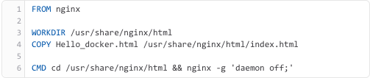
Sample Docker File
1. docker run --name test_nginx -p 8080:80 -d aneeshep/test
2. docker run --name test_nginx -p 8080:80 -d aneeshep/test
3. docker run --name test_nginx -p 8080:80 -v /tmp/nginx:/usr/share/nginx/html -d aneeshep/test

Slide 22
Docker CLI
docker images # List all images on a Docker host
docker build # Build an image from a Dockerﬁle
docker run # Run an image
docker ps # List all containers
docker stop # Stop a containers
docker rm # Remove an containers
docker rmi # Remove an image

Slide 23
Thank You

